Slide 1
Standardized, FAIR and CF-compliant publication of urban climate model data
K. Heinke Schlünzen^{UHH}, David Grawe^{UHH}, Vivien Voss^{UHH}
Angelika Heil^{DKRZ}
Anette Ganske^{TIB}
Jan Kretzschmar^{ULei}
User Workshop @ EMS 2021
Tue, 07 Sep, 11:00–12:30 (CEST)
https://meetingorganizer.copernicus.org/EMS2021/session/41771#

Slide 2
On Publication of Urban Climate Model Results
Status
Data rarely published
Data not findable
Need for published data increasing (researchers, planners, …)
Project aim: increase reusability of urban climate data
Workshop objectives
Explain standards (FAIR, CF, NetCDF, ATMODAT)
Learn to use a software to check if your data fulfil a standard
Jointly determine model output variables that need to be standardized
Next steps

Slide 3
Why do we need data publication standards?
More and more data are being published,
but
often they are not reusable because they are:
not adequately described,
stored in file formats that cannot be read and processed with open software,
not findable by search engines.

Slide 4
What hinders a standardised data publication?
Many data producers do not know how to correctly standardise their data for publication.
Only a few data repositories support data producers by advising them and/or by controlling the standardisation of submitted data.
There are few incentives to standardise data.

Slide 5
What are the key principles of a standardised data publication?
The FAIR principles
most widely adopted guiding principles for scientific data management and stewardship (Wilkinson et al. 2016*).
aim at improving the Findable, Accessible, Interoperable, Reusable of digital assets.
can be applied within all research disciplines.
put specific emphasisis on enhancing machine actionability, but also target improving human readibility.
* https://doi.org10.1038/sdata.2016.18

Slide 6
FAIR data principles
(Meta)Data have a Persistent Identifier (PID)
(Meta)data are stored in an open repository
Data are detailed described through metadata
(Meta)data can be downloaded in a standardised way
Accessible
Metadata can still be accessed even if the data was deleted
Standardised wording - controlled vocabulary
References to other (meta)data
Specify licence
Adhere to community standards
Notes:
Findable:
Data and metadata (i.e. (meta)data) have a PID, for example, a DOI. In general, data and corresponding metadata have the same PID.
Open respository: Data stored locally on a USB stick or so cannot be found; they have to be web-accessible and open (means not restricted by password or user group).
Search machines search in metadatdata for specific terms. If there are no such metadata, the search machine cannot find the data.
Accessible:
(1) download protocol such as ftp....download of data and metadata has to be technically possible.
(2) some repository delete their data; if the data have a DOI, the landing page must prevail..and the landing page has to mention that the data were deleted.
Interoperable:
Many evaluations are done automatically. The machines and frequently also people do not know if the same variable is meant. For example: Air temperature versus surface temperature versus 2m temperature……It is therefore important to use standardised wording, such as for example CF standard names which provide a single, unambiguous term which makes the information machine actionable.
Reference to other related datasets, e.g. other MIP experiments. what is the relation of my data to other data? where is the description of the experiment/the entire framework?
Reusable:
If you do not know what licence the data have, it is problematic to use them. Is it open or not? Licence specifies under which conditions the data may be used. E.g. use international standardised licence CC BY 4.0. /BY means
Use data formats that are easily useable by most members of the target community….. Nothing exotic….Shapefile GIS not known in the climate modellers.
FAIR targets machine-processible….see more: A short guide to increase FAIRness of atmospheric model data. https://doi.org/10.1127/metz/2020/1042.

Slide 7
Persistent Identifiers (PIDs) for Data: DOI
Digital object identifier (DOI): PID used to identify objects uniquely (standardised by ISO)
DataCite: global non-profit organisation that provides Digital Object Identifier (DOI) for research data
DataCite DOI:
Persistent and unique identifier for research data
Resolves directly to a landing page which displays the metadata and download instructions
Easy to cite, e.g. https://doi.org/10.1594/WDCC/CMAQ_CCLM_HZG_2008
Enables machine readability (link and metadata)
Notes:
There are many different PIDs for data: DOI, handle and URN:NBN; here we focus on DOIs.

Slide 8
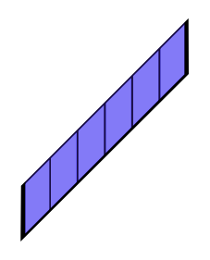
Climate and Forecast (CF) Metadata Conventions
CF most widely used data standard for earth science data (first released in 2003).
CF targets interoperability & reusability of information stored in netCDF* data files
CF-netCDF: CF-compliant netCDF file using CVs & other self-describing metadata
A NetCDF file has dimensions, variables, and attributes.
temperature (x,y,t)
pressure
(x,y,t)
latitude
(x,y)
longitude
(x,y)
Metadata for
– Variables
– Dimensions
– Global
time
(t)
latitude x
longitude y
time t
time (t)
Data Variables
Coordinate Variables
Dimensions
Attributes
*network Common Data Form: machine-independent binary data formats for array-oriented science data.
Notes:
Self-Describing: netCDF file can include information about the data it contains.
Figure adapted from https://openresearchsoftware.metajnl.com/articles/10.5334/jors.148/

Slide 9
CF Standard names
CF Standard names
– are a tool for a FAIR description of variables in NetCDF files.
– are unique text strings constructed using controlled vocabulary
– have a precise definition and an associated SI unit. – are the value for the standard_name variable attribute, e.g.
float co(time,lat, lon) ; co:standard_name = "mole_concentration_of_carbon_monoxide_in_air” co:units = "mol m-3”
The set of permissible standard names is contained in the CF standard name table*, which currently encompasses 4500 entries
Standard name. ≠ netCDF variable name
* https://cfconventions.org/Data/cf-standard-names/77/build/cf-standard-name-table.html
Notes:
One element of the CF conventions is to use unequivocal standard names to describe geophysical quantities.

Slide 10
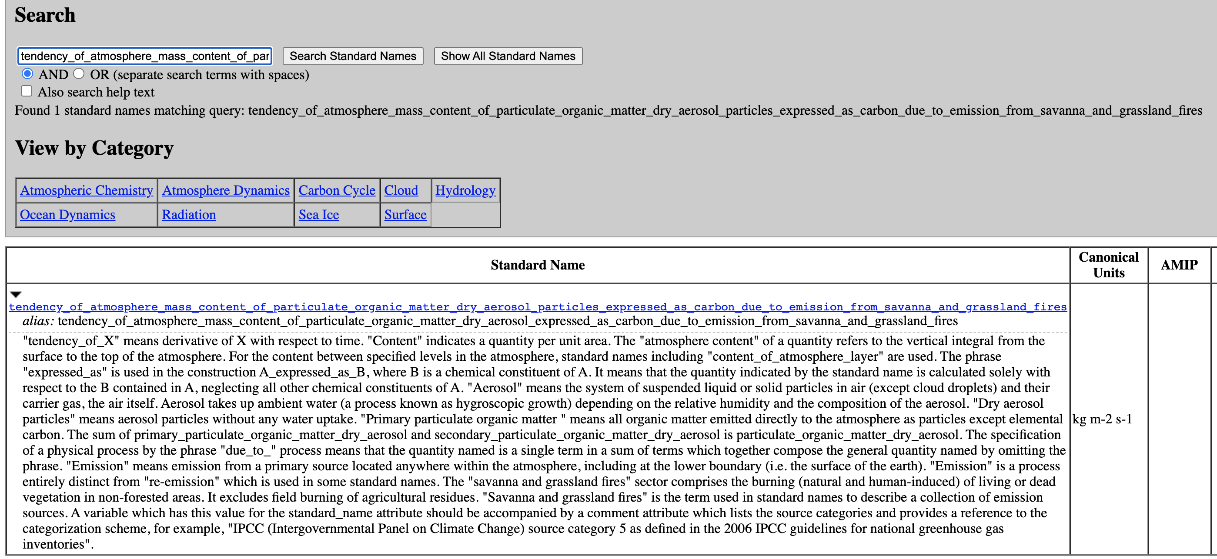
CF Standard names
https://cfconventions.org/Data/cf-standard-names/77/build/cf-standard-name-table.html

Slide 11
CF Standard names
New CF standard names can be proposed to the CF community.
The CF community publicly discusses proposals in terms of (a) consistency with the CF rules and (b) relevance.
AtMoDat project has recently proposed standard names for airborne pollen concentrations

Slide 12
Proposed CF Standard Name for Pollen
float pollen_conc(time,lev,lat,lon,taxon) ;
pollen_conc:standard_name = "number_concentration_of_biological_taxon_pollen_grains_in_air“ ;
pollen_conc:units = „m-3“ ;
pollen_conc:coordinates = "taxon_lsid taxon_name“ ;
pollen_conc:long_name = „airborne pollen concentration“ ;
char taxon_name(taxon,string80) ;
taxon_name:standard_name = "biological_taxon_name“ ;
taxon_name:long_name = „pollen (Latin name)" ;
char taxon_lsid(taxon,string80) ;
taxon_lsid:standard_name = "biological_taxon_lsid“ ;
taxon_lsid:long_name = „ITIS identifier“ ;
taxon_lsid:url = „https://www.itis.gov/“ ;
char pollen_common_name(taxon,string80) ;
pollen_common_name:long_name = „pollen (common name)“ ;
pollen_common_name:description = „Common names as listed in ITIS“ ;
pollen_common_name:url = „https://www.itis.gov/“ ;
data:
time = 6., 12., ... ;
lat = 1., 2., ... ;
lon = 5., 6., ... ;
pollen_conc = 0.0087, 0.28367, ... ;
taxon_name = "Betula L.", "Poaceae", "Artemisia L.", "Ambrosia L.", "Secale L.", "Alnus Mill.";
taxon_lsid ="urn:lsid:itis.gov:itis_tsn:19478", "urn:lsid:itis.gov:itis_tsn:40351", "urn:lsid:itis.gov:itis_tsn:35431", "urn:lsid:itis.gov:itis_tsn:36495", "urn:lsid:itis.gov:itis_tsn:42089", "urn:lsid:itis.gov:itis_tsn:19466", "urn:lsid:itis.gov:itis_tsn:32928", "urn:lsid:itis.gov:itis_tsn:19505", "urn:lsid:itis.gov:itis_tsn:32989", "urn:lsid:itis.gov:itis_tsn:19461", "urn:lsid:itis.gov:itis_tsn:19276“ ;
pollen_common_name="birch", "grasses", "sagebrush", "ragweed", "rye", "alder" ;
dimensions:
string80 = 80 ;
taxon = 6 ;

Slide 13
The ATMODAT standard (Ganske et al., 2021*)
quality guideline for a FAIR publication of atmospheric model data with open licences.
guides data producers and data curators.
specifies requirements for data and metadata.
contains checklists allowing a quick and easy verification if the (meta)data are compliant with the ATMODAT standard.
* ATMODAT Standard (v3.0) https://doi.org/10.35095/WDCC/atmodat_standard_en_v3_0
Notes:
Within the project we developed the ATMODAT standard with the aim to increase and enhance the fair publication of model data.
Basically, this standard is a quality guideline for a FAIR publication of atmospheric model data with open licenses.
This standard contains guidelines for the data producer and data curator to achieve FAIR data, with specified requirements on how the data and metadata should be provided.
All those aspects are summarized in checklist, that allow a quick and easy verification if the meta data and data are compliant with the ATMODAT standard and therefore FAIR.

Slide 14
ATMODAT standard: key elements
assumes a data publication with a DataCite DOI.
defines NetCDF as data format.
defines adherence to the Climate and Forecast (CF) conventions.
defines mandatory, recommended and optional metadata.
ATMODAT standardisation
Data Files
DOI Metadata
Landing Page
Notes:
On this slide you can see the key elements of our standard.
For the publication of a dataset with the ATMODAT standard, the following aspects should be covered.
The data publication should be assumed as a data publication with a DataCite DOI, this should enhance the identification of the data itself.
For the Publication of the Data the netCDF data format is required
the dataset should be adherence to the Climate and Forecast conventions, using the standardized variable descriptions and units.
Within this standard, the metadata is divided into three categories: mandatory, recommended and optional metadata. This means mandatory metadata should be always provided with the data set, while optional metadata can be additional information which are nice to have.
The standardization contains three elements of a data publication: The dataset itself, the DOI Metadata and the landing page.
Information of the Data Files are provided by the data producer
Information on the DOI Metadata are managed by the data curator
The landing page are maintained by the data provider with the information given from the data producer

Slide 15
Requirements for Data Files
Always NetCDF
netcdf CD24_base_2008_dec_1_1915785082846561030 {
dimensions:
...
variables:
float gas_so2(time, z, y, x) ;
gas_so2:coordinates = "lon lat" ;
gas_so2:grid_mapping = "Lambert_Conformal" ;
gas_so2:missing_value = -9.e+33f ;
gas_so2:standard_name = "mass_concentration_of_sulfur_dioxide_in_air" ;
gas_so2:units = "kg m-3" ;
gas_so2:long_name = "SO2 concentration" ;
...
//global attributes:
:Conventions = "CF-1.6" ;
:institution = "Helmholtz-Zentrum Geesthacht, …..." ;
:source = "model: CMAQ v5.0.1 cb05tump ae5; ….." ;
:summary = "Standard CMAQ Model run over Northwestern Europe […] " ;
:title = "Concentrations of gaseous pollutants and particulate compounds
over Northwestern Europe […] in 2008";
:creation_date = "2015-04-02" ;
:crs = "spherical earth, R = 6370 km" ;
:history = "... abbreviated ..." ;
Coordinate system
CF Conventions/ Controlled Vocabulary
AtMoDat is currently working on an extension of the CF Conventions
Coordinate reference system
Notes:
This is an example of the header of a netCDF File.
As mentioned before we claim netCDF as a mandatory file format and we see here an example for a variable and the global attributes.
Based on the AtMODAT standard each variable should be sufficient described.
Self-describing attributes are necessary, standard name and units should be compliant with the CF convention, other information like the used coordinate systems and the coordinate reference system are also required.
In the global attribute section, information about the general dataset are stored. For example, this includes the description of the purpose of the data, the institution, model name creators and so on.
All these Information stored in the dataset are given by the data producer.
Urban modelling is also a part of the ATMODAT project. Within this project we are currently working on an extension of the CF convention, because they do not sufficiently cover variables which are common in the urban scale modeling.

Slide 16
Requirements for DOI Metadata
"id":"10.1594/wdcc/cmaq_cclm_hzg_2008",
"doi":"10.1594/wdcc/cmaq_cclm_hzg_2008",
…...
"creators":[{
"name":"Neumann, Daniel",
“nameType":"Personal",
"nameIdentifiers":{
"nameIdentifier":"https://orcid.org/0000-0001-8574-9093",
"nameIdentifierScheme":"ORCID",
"schemeUri":"https://orcid.org"},
"affiliation":{
"name":"Leibniz -Institut fuer Ostseeforschung Warnemuende (IOW)",
"affiliationIdentifier":"https://ror.org/03xh9nq73",
"affiliationIdentifierScheme":"ROR",
"SchemeURI":"https://ROR.org",
….
"dates": "2017-06-08",
…
PIDs (ORCID, ROR) for persons, organisations, funders
Standardized dates
Notes:
This slide here shows the requirements for the DOI Metadata, which are necessary for the identification and publication process. This information should be provided by the data curator.
For the identification of the dataset, standardized information are required, as well as persistent identifications for each person, organization or funders who where involved in the creation of the dataset.
PID like the orchids of the persons or RORs of the institutions should be applicated to the dataset.

Slide 17
Landing Page (human-readable): requirements
Sub-pages with details on datasets or variables
Contact person with ORCID
Use of Controlled Vocabulary
Spatial and temporal coverage of the data
Download access to the data
Notes:
inally, the requirements for the landing page are divided into a human-readable part and a machine-readable part.
A landing page should be the first thing you see, if you are searching online for a dataset for your purposes.
The landing page should describe the dataset, so that you can easily decide if you want to use the data.
The human readable landing page should be easily readable by the user, you can find subpages with further information about the dataset itself or the containing variables.
You can find the contact information in case you have further question.
With the use of the controlled vocabulary you can easily see if the dataset fits your field of interest. As well as the information on the spatial and temporal coverage.
Lastly, you can find a link, were you can download the described data.

Slide 18
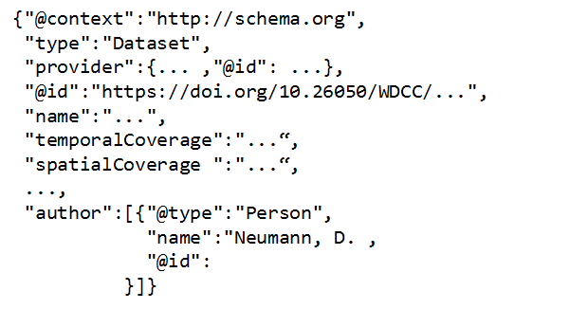
Landing Page (machine-readable): requirements
Machine interpretable language
PIDs for all persons, organisations, funders
Notes:
Requirements for the machine-readable landing page are the usage of a machine-readable language, so that the page can be found and interpreted by search engines. Also the storage of the PIDS on the machine landing page also enhance a quick identification of the corresponding persons and enhancing the data search.
All the Information on the Landing page are provided by the Data producer and implemented and maintained by the data curator and provider.

Slide 19
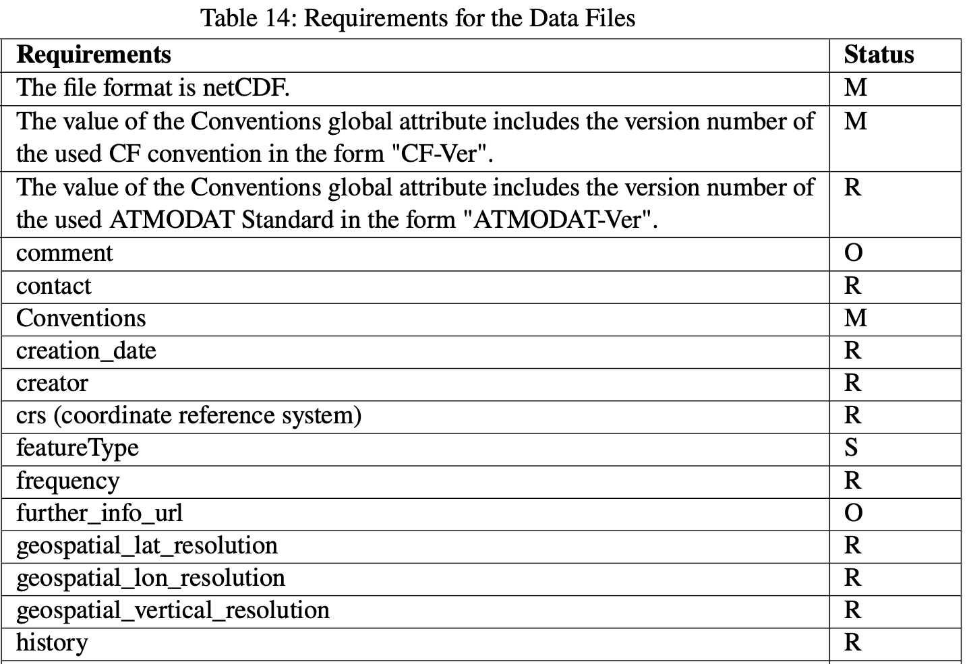
ATMODAT Checklists:
Tables with summary
specifications for
DataCite metadata
landing page
data files
Quick overview of required specifications for data producers and curators.
M=Mandatory, R=Recommended, O=Optional
Notes:
All the requirements and attributes are summarized in tables, provided with the ATMODAT standard.
They contain the specifications for the DataCite Metadata, landing page and data file.
These tables give a quick overview for the data producer and data curator, what the data set should contain in order to fulfill the ATMODAT criteria and enable a FAIR data publication.
The table on the right, shows a short overview for the requirements for the dataset, provided by the producer and the corresponding status.
For example: the file format netCDF is labeled as M, which means mandatory, while additional comments on the dataset, stored in the header is optional.
Contact information for example are recommended.

Slide 20
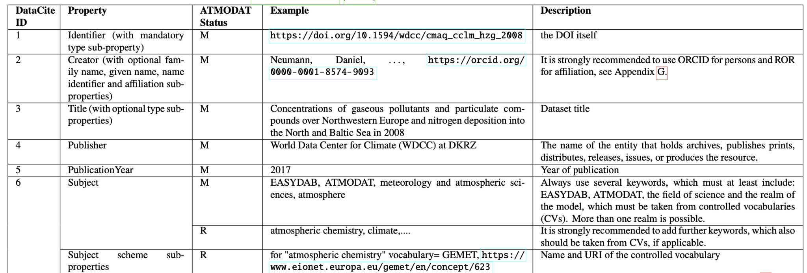
ATMODAT Checklists: Detailed Specifications
Table 2: List of all DOI metadata properties (Table for curators)
Mandatory (M)
Recommended (R)
All reasonable recommended (R) metadata should be entered.
Notes:
Here we see a more detailed table with the specifications for the DOI Metadata, which are provided by the data curator. Additional information like the description of the property and an example on how to fill the properties are mentioned here.
Both types of Table, the short summary table as well as the detailed table are available for each element of the standard: for the landing page, Doi Metadata and dataset itself.
With this tables, each step of the application of the standard is clearly described and defined.

Slide 21
atmodat checker
https://github.com/AtMoDat/atmodat_data_checker
Data standardisation steps prior their publication:
Step 1) Make data files compliant with discipline-specific standard.
Step 2) Use a checker to control that data files are correctly standardised
How are CMIP data standardised?
– CMOR tool for standardising data
– Control with PrePARE Checker and CF-checker
– Poblem: tools lacks flexibility to be used for datasets outside CMIP when other standardisation requirements
→ For data that shall comply with the ATMODAT Standard, we developed the AtMoDat Standard Compliance Checker (checks global attributes + integrated the CF-checker)

Slide 22
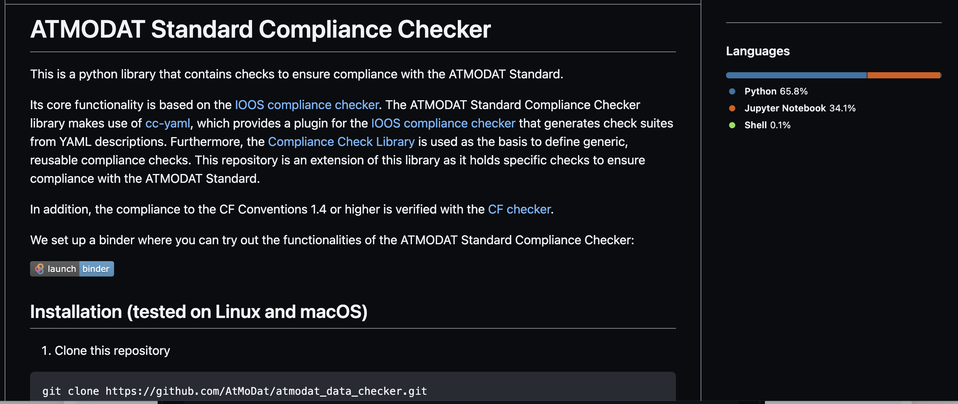
atmodat checker
https://github.com/AtMoDat/atmodat_data_checker

Slide 23
atmodat checker
https://github.com/AtMoDat/atmodat_data_checker
IOOS Compliance Checker adapted for ATMODAT standard
File or directory to be checked
Collection of output from both checkers:
short/long summary detailed individual ourput
run_checks.py
Command line interface with options on checks to be performed
CF-checker
Output of results in several format
(e.g. text, csv, json)

Slide 24
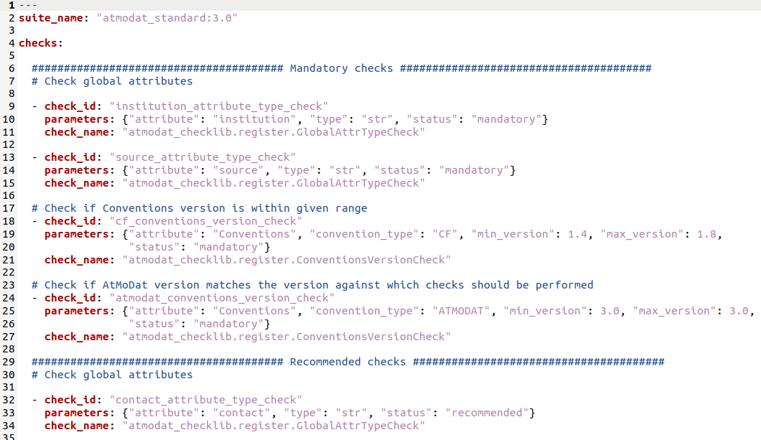
atmodat checker
https://github.com/AtMoDat/atmodat_data_checker
Checks are defined in a yaml-file which users could adjust to defined their own checks

Slide 25
atmodat checker
https://github.com/AtMoDat/atmodat_data_checker
Example short summary.txt: run_checks.py –s –f testfile.nc
Short summary of checks:
Checking against: atmodat_standard:3.0, CF table version: 77
Version of the AtMoDat checker: 1.1.0
Checked at: 2021-08-11T14:54:17.517485
Number of checked files: 1
Total checks passed: 4/31
Mandatory checks passed: 2/4
Recommended checks passed: 2/18
Optional checks passed: 0/9
CF checker errors: 1

Slide 26
atmodat checker
https://github.com/AtMoDat/atmodat_data_checker
If errors are reported with regard to CF conformity or global attributes, attributes need to modified
Relatively simple to define new checks and new check suites for different applications in future
Easy to install; accessible via github, but plans to provide packages via PyPi/Anaconda
We will provide simple python scripts that can be used to fill global/variable attributes in netCDF files from a csv table (“atmodat attribute filler”, release in near future)

Slide 27
atmodat checker
https://github.com/AtMoDat/atmodat_data_checker
Let’s try it out
https://hub-binder.mybinder.ovh/user/atmodat-atmodat_data_checker-2o024vmi/tree/notebooks
→ see link posted in the chat

Slide 28
Open Issues
Issue many variables relevant in urban climate
have no CF standard names
Examples derived variables
building variables
Solution add names to CF standard

Slide 29
Derived variables
Derived variables
with high spatial variability
Variable Standard name (suggested) Unit
PT perceived_temperature degree_C
UTCI universal_thermal_climate_index degree_C
TMRT mean_radiant_temperature K
PET physiological_equivalent_temperature degree_C

Slide 30
Building variables
Variable Standard name (suggested) Unit
Building mask volume_fraction_of_obstacles_in_air 1
Surface variables
building cells are geometrically complex, e.g. surface temperature needs to be stored for each surface
six geometric surfaces are possible, up to three occur per cell

Slide 31
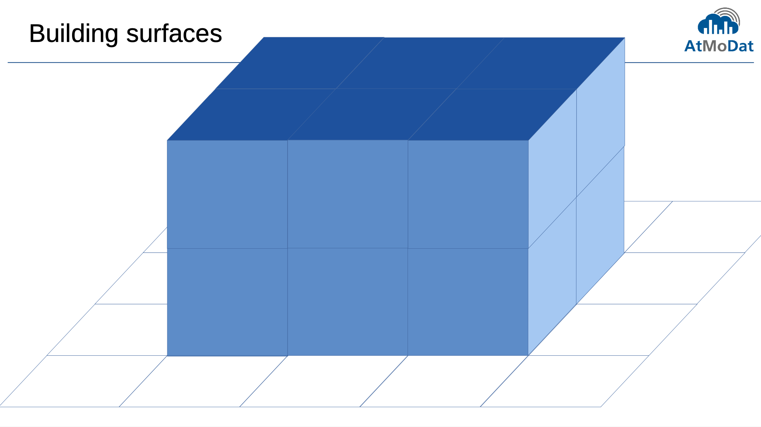

Slide 32
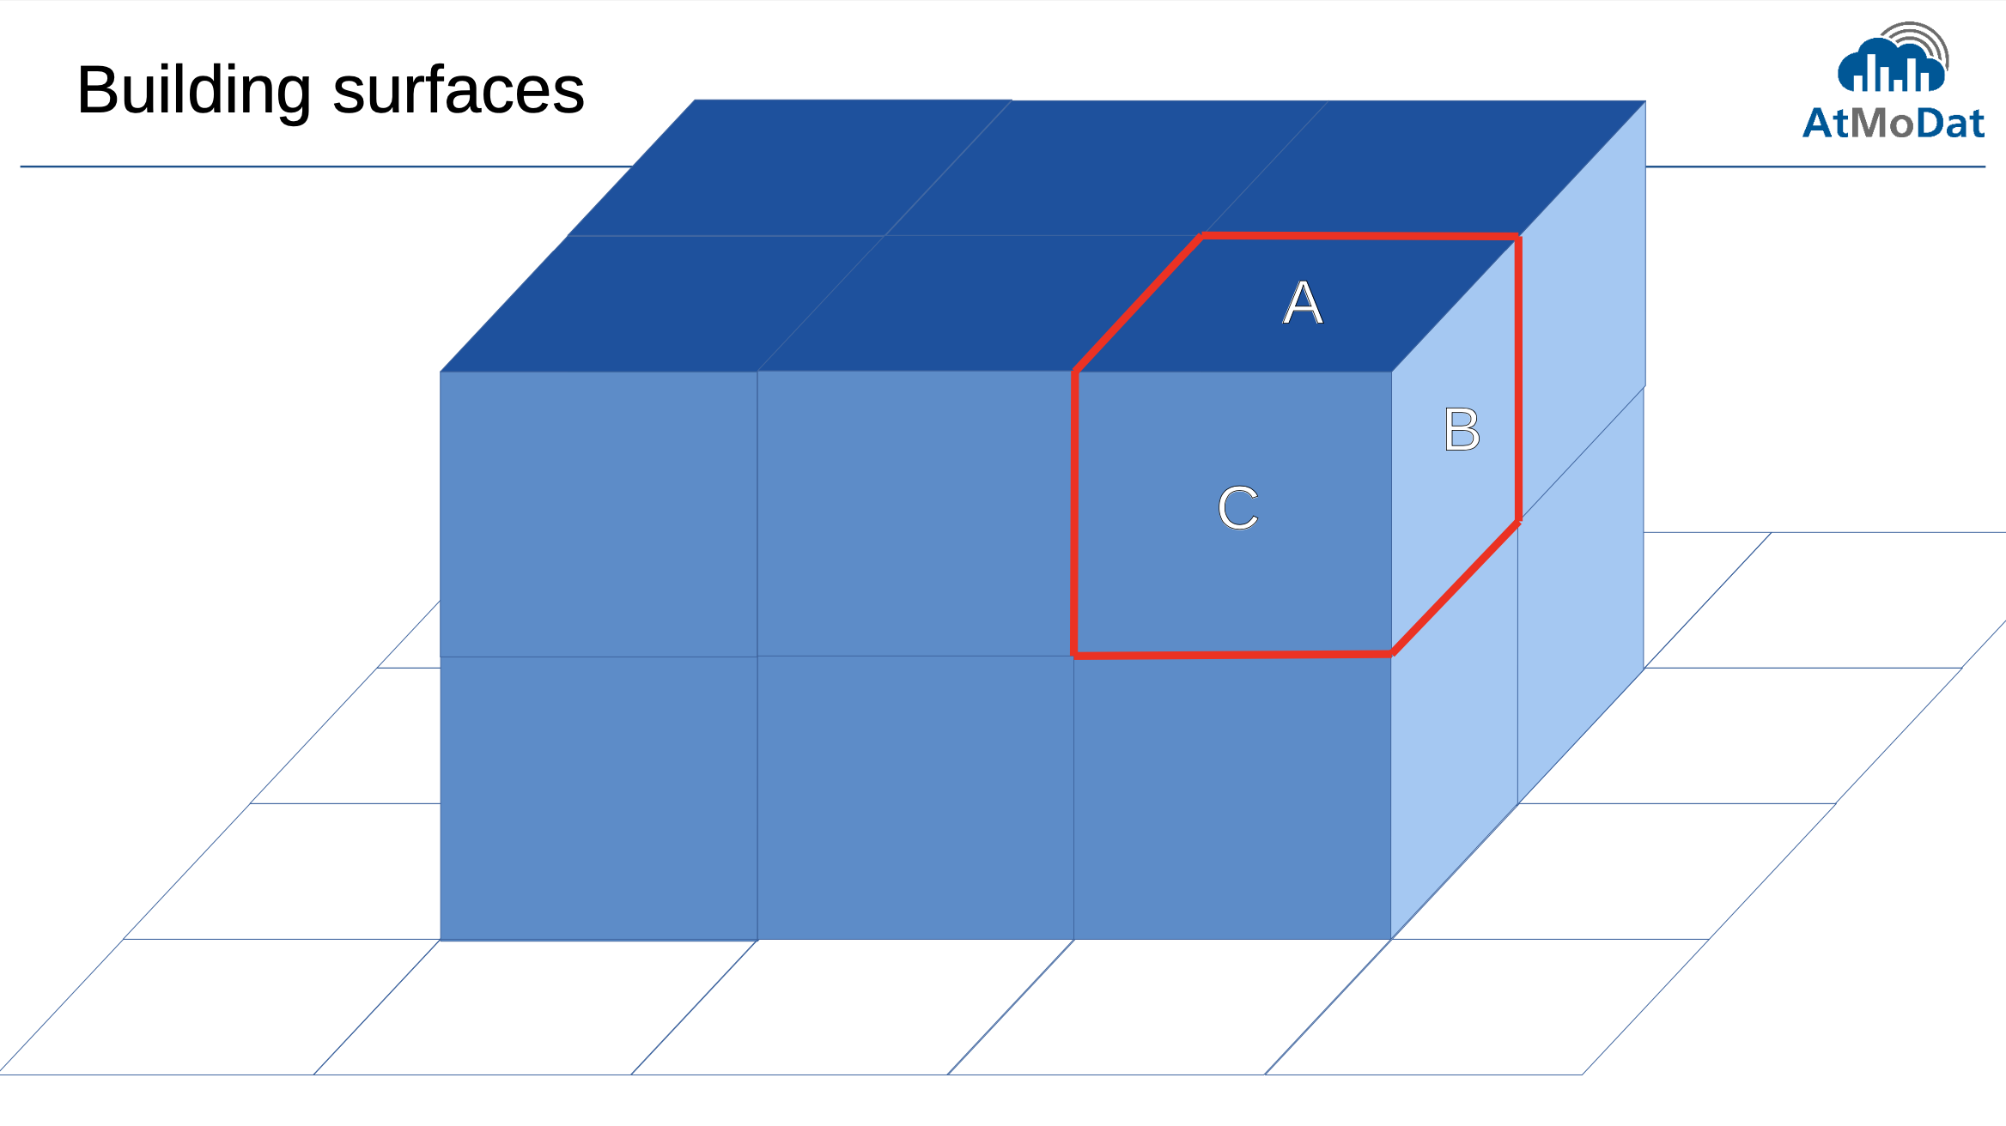

Slide 33
(suggested)
(suggested)

Slide 34
Sparsity of data
Building data is sparse
because buildings are usually attached to the ground while the top of the domain may be several building height above
store building data as 3d data or via index field?
compromise: 3d field up to a certain height

Slide 35
Conclusions and next steps
Data publication is not so difficult
Software helps to check for fulfilling standards (AtMoDat checker)
More standard names need to be defined with more urban modelers publishing their data
For more information
https://www.atmodat.de/
Next workshop where you can come with your own data 09. Nov. 2021 Register at https://indico.dkrz.de/event/14/

